Slide 1
INTRODUCTION TO COMPUTING
Course Code: CCINCOM/L
Model Free Control
Elizer Ponio Jr.
Faculty Member
Department of Computer Science
College of Computing and Information Technologies (CCIT)
National University
Joseph Marvin R. Imperial
REINFORCEMENT LEARNING
NU College of Computing and Information Technologies
Course Code: CCRNFLRL

Slide 2
Recap
INTRODUCTION TO COMPUTING
Course Code: CCINCOM/L
Joseph Marvin R. Imperial
REINFORCEMENT LEARNING
NU College of Computing and Information Technologies
Course Code: CCRNFLRL

Slide 3
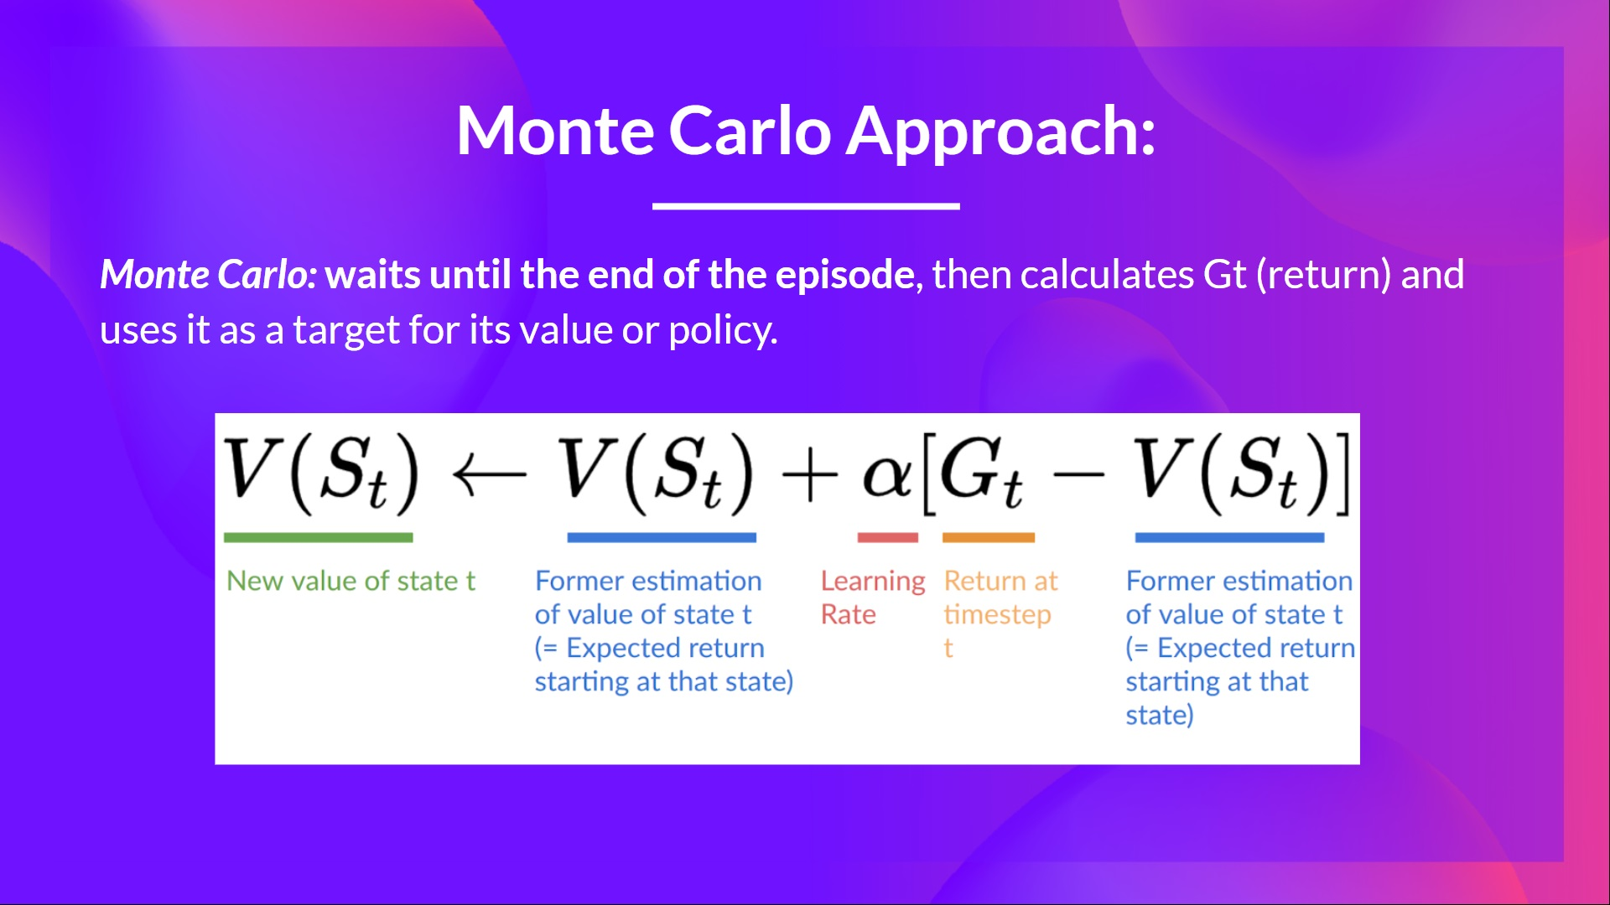
INTRODUCTION TO COMPUTING
Course Code: CCINCOM/L
Joseph Marvin R. Imperial
REINFORCEMENT LEARNING
NU College of Computing and Information Technologies
Course Code: CCRNFLRL

Slide 4
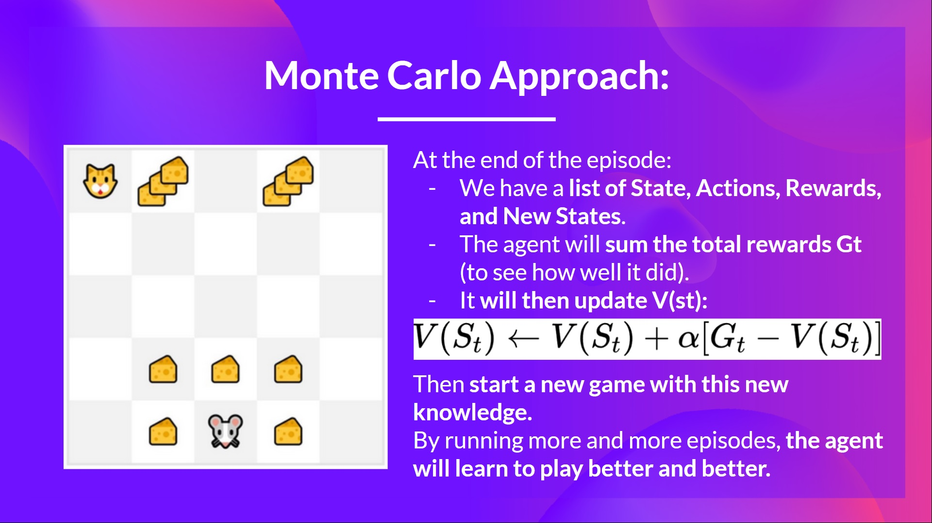
INTRODUCTION TO COMPUTING
Course Code: CCINCOM/L
Joseph Marvin R. Imperial
REINFORCEMENT LEARNING
NU College of Computing and Information Technologies
Course Code: CCRNFLRL

Slide 5
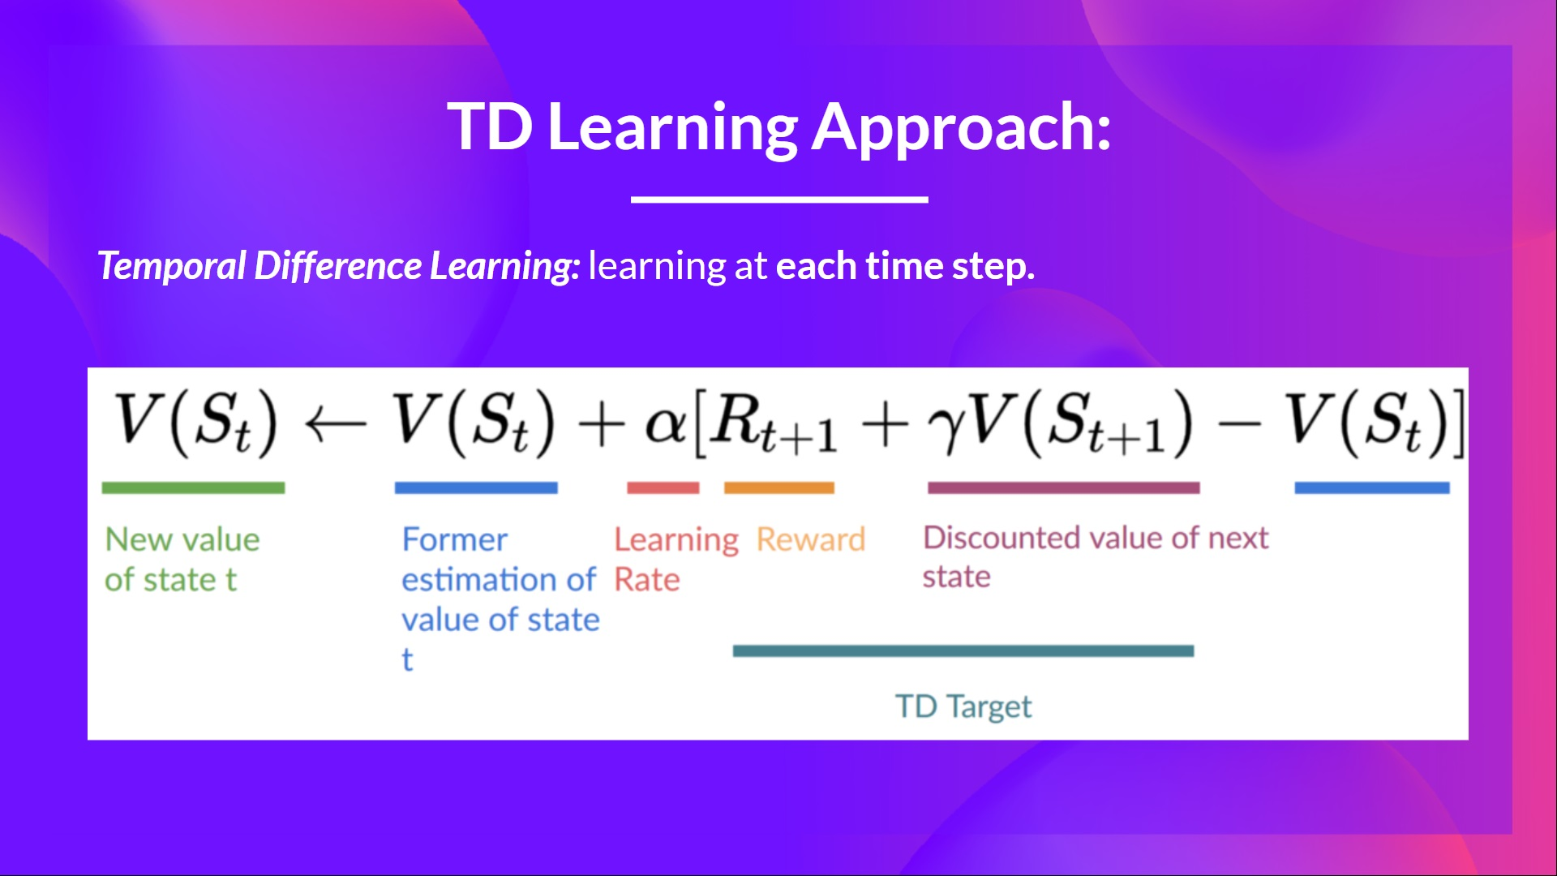
Refresher
INTRODUCTION TO COMPUTING
Course Code: CCINCOM/L
Joseph Marvin R. Imperial
REINFORCEMENT LEARNING
NU College of Computing and Information Technologies
Course Code: CCRNFLRL

Slide 6
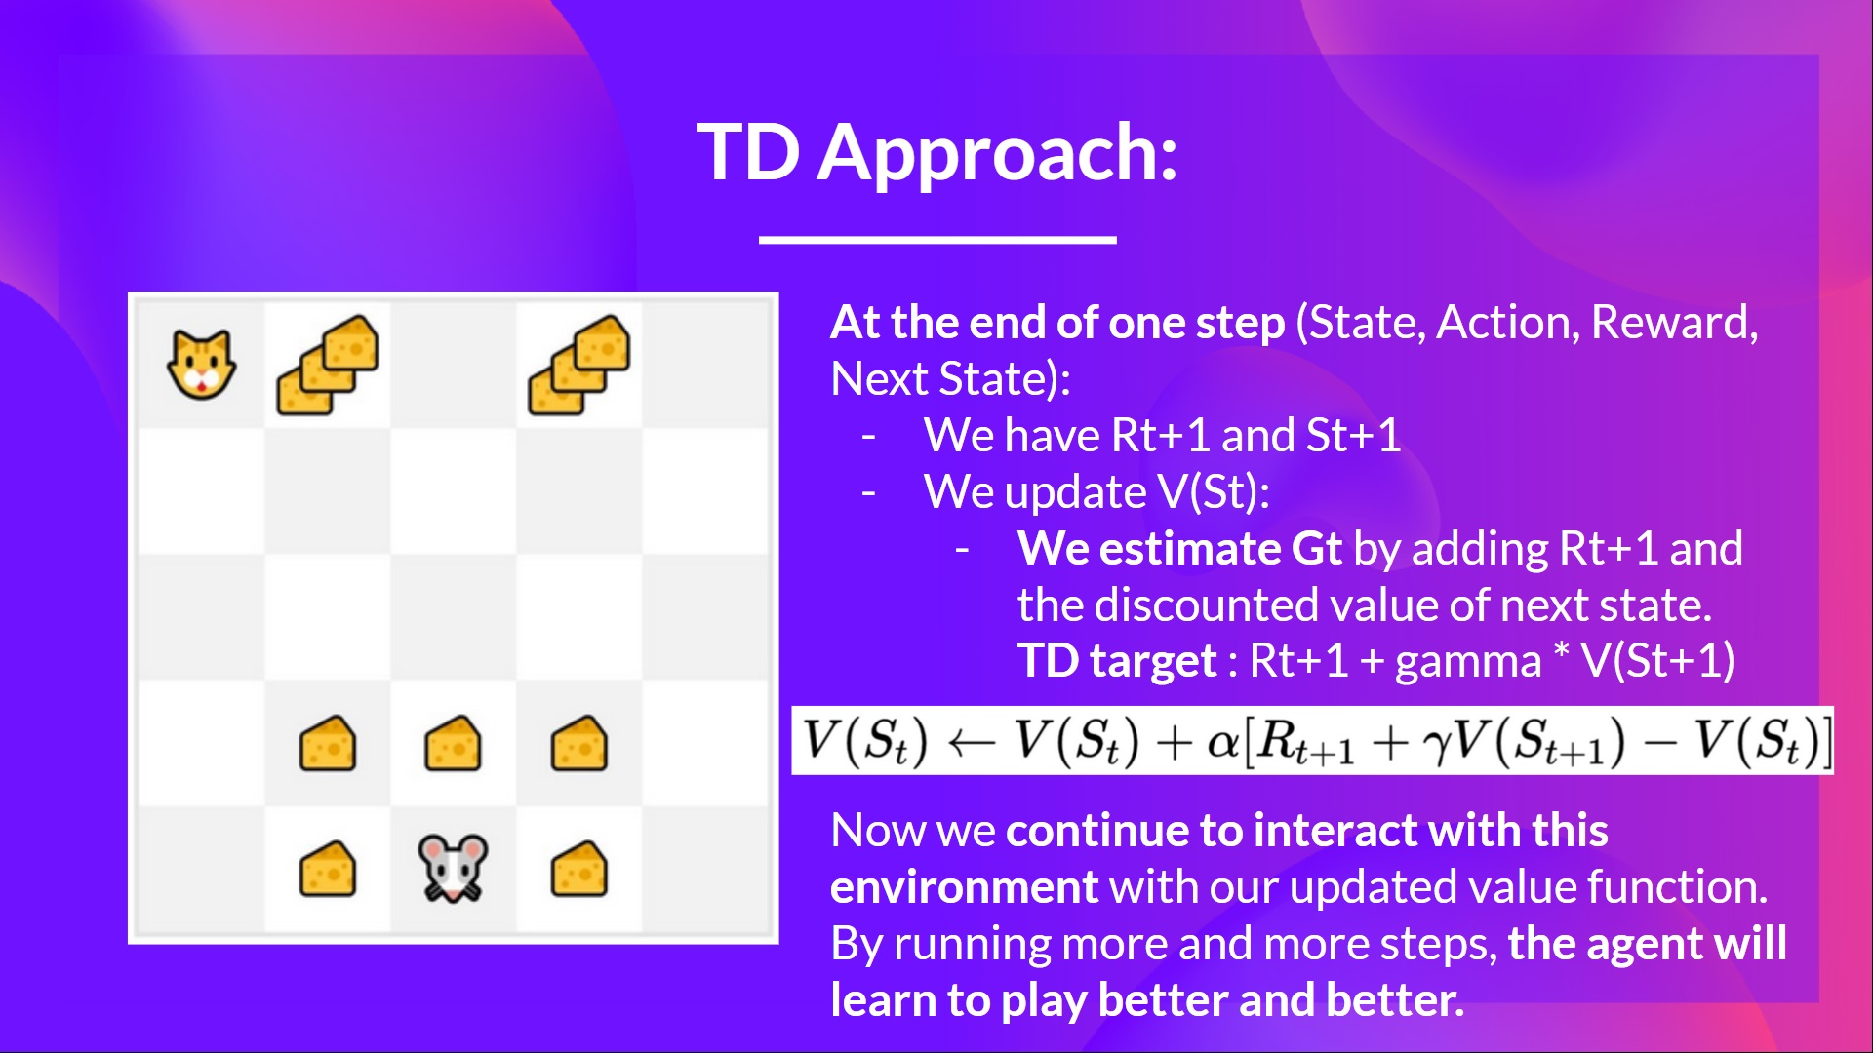
Refresher
INTRODUCTION TO COMPUTING
Course Code: CCINCOM/L
Joseph Marvin R. Imperial
REINFORCEMENT LEARNING
NU College of Computing and Information Technologies
Course Code: CCRNFLRL

Slide 7
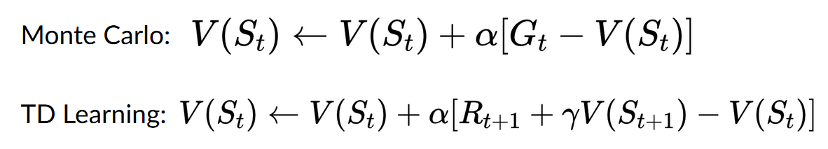
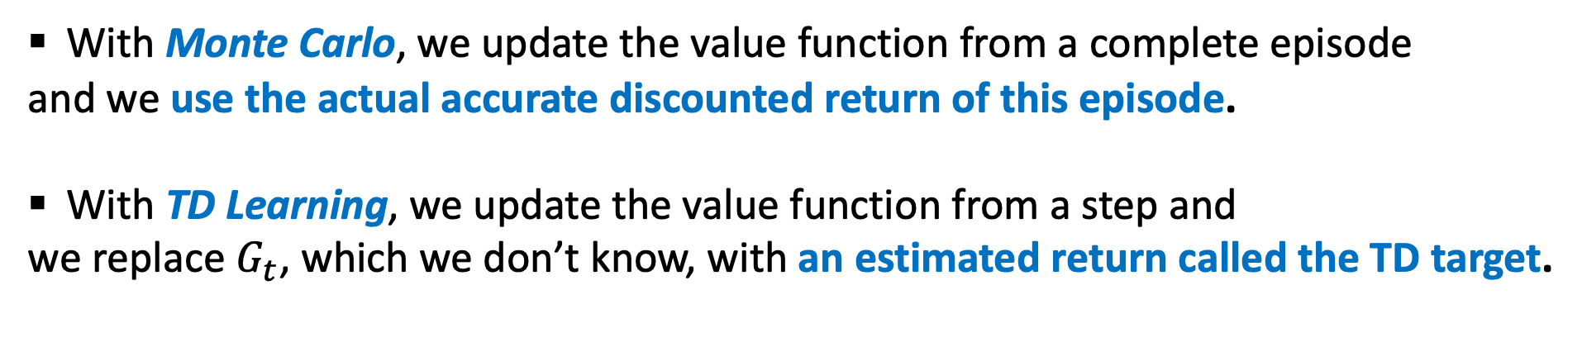
Recap
INTRODUCTION TO COMPUTING
Course Code: CCINCOM/L
With Monte Carlo, we update the value function from a complete episode
and we use the actual accurate discounted return of this episode.
With TD Learning, we update the value function from a step and
we replace $G_{t}$, which we don’t know, with an estimated return called the TD target.
Joseph Marvin R. Imperial
REINFORCEMENT LEARNING
NU College of Computing and Information Technologies
Course Code: CCRNFLRL

Slide 8
Outline
INTRODUCTION TO COMPUTING
Course Code: CCINCOM/L
Introduction
On-Policy and Off-Policy
ε-Greedy Exploration
On-Policy
GLIE Monte-Carlo
SARSA
Off-Policy
Q-Learning
Joseph Marvin R. Imperial
REINFORCEMENT LEARNING
NU College of Computing and Information Technologies
Course Code: CCRNFLRL

Slide 9
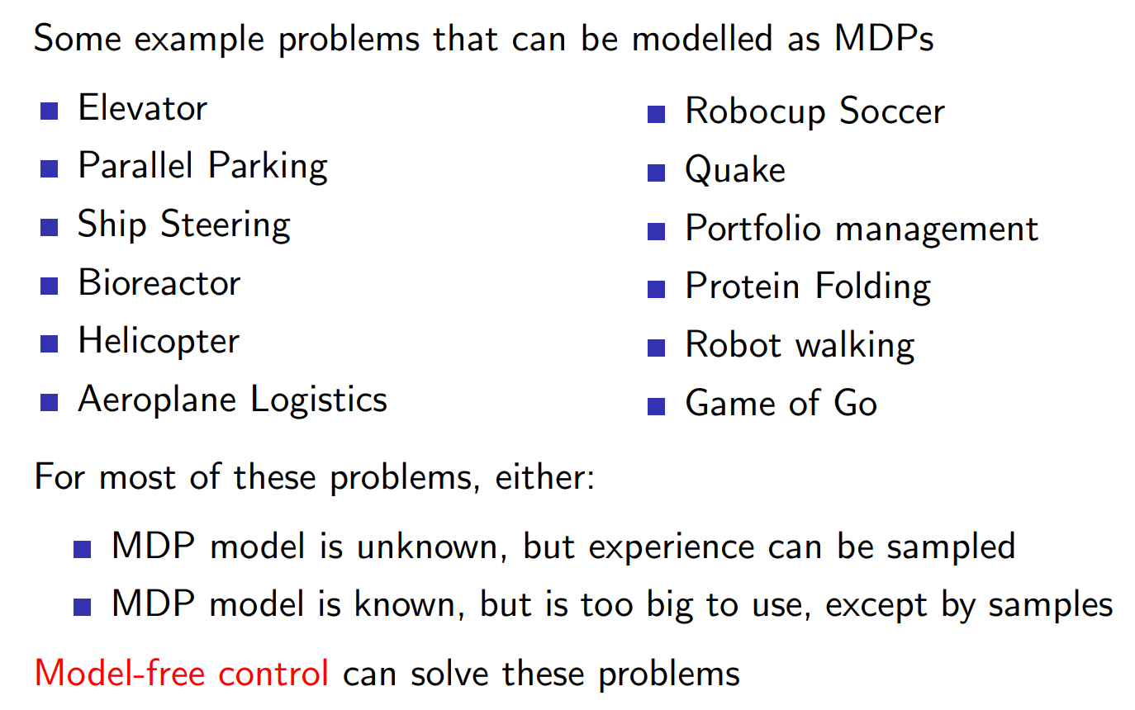
Uses of Model-Free Control
INTRODUCTION TO COMPUTING
Course Code: CCINCOM/L
Joseph Marvin R. Imperial
REINFORCEMENT LEARNING
NU College of Computing and Information Technologies
Course Code: CCRNFLRL

Slide 10
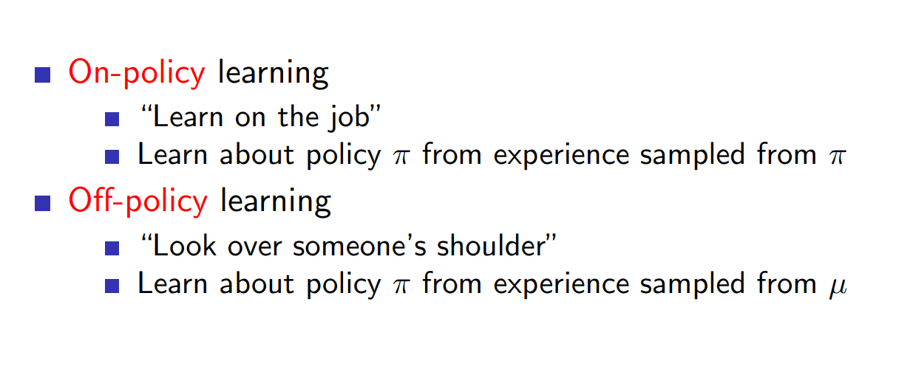
On-Policy and Off-Policy
INTRODUCTION TO COMPUTING
Course Code: CCINCOM/L
Joseph Marvin R. Imperial
REINFORCEMENT LEARNING
NU College of Computing and Information Technologies
Course Code: CCRNFLRL

Slide 11
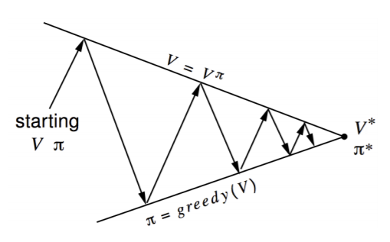
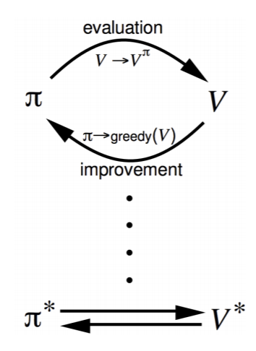
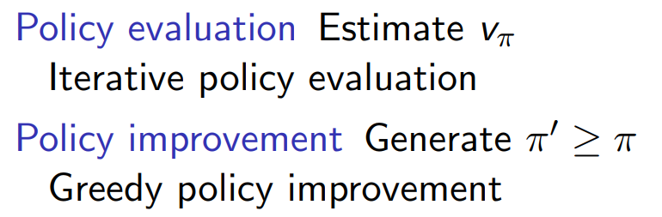
Generalised Policy Iteration (Refresher)
INTRODUCTION TO COMPUTING
Course Code: CCINCOM/L
Joseph Marvin R. Imperial
REINFORCEMENT LEARNING
NU College of Computing and Information Technologies
Course Code: CCRNFLRL

Slide 12
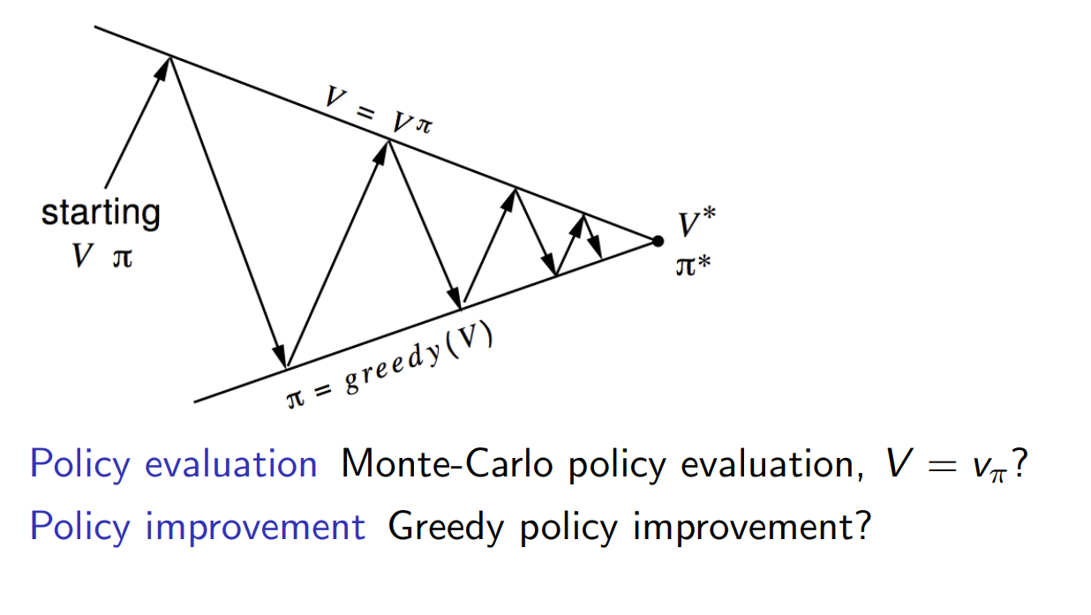
Generalised Policy Iteration with Monte-Carlo
INTRODUCTION TO COMPUTING
Course Code: CCINCOM/L
Joseph Marvin R. Imperial
REINFORCEMENT LEARNING
NU College of Computing and Information Technologies
Course Code: CCRNFLRL

Slide 13
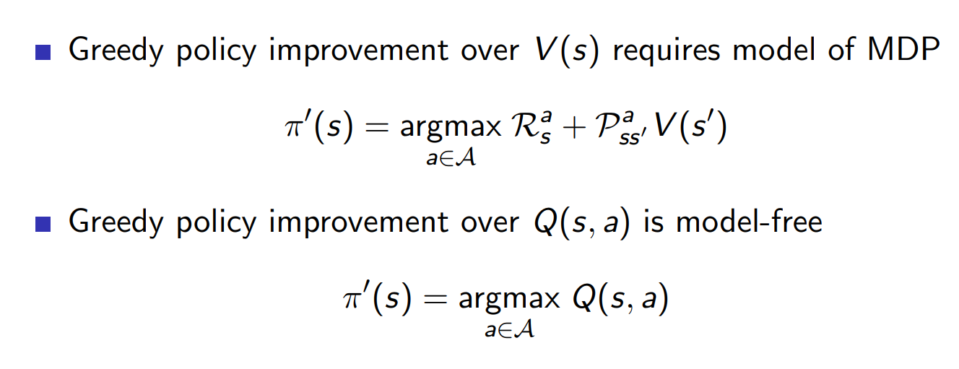
Model Free Policy Iteration using Action-Value Function
INTRODUCTION TO COMPUTING
Course Code: CCINCOM/L
Joseph Marvin R. Imperial
REINFORCEMENT LEARNING
NU College of Computing and Information Technologies
Course Code: CCRNFLRL

Slide 14
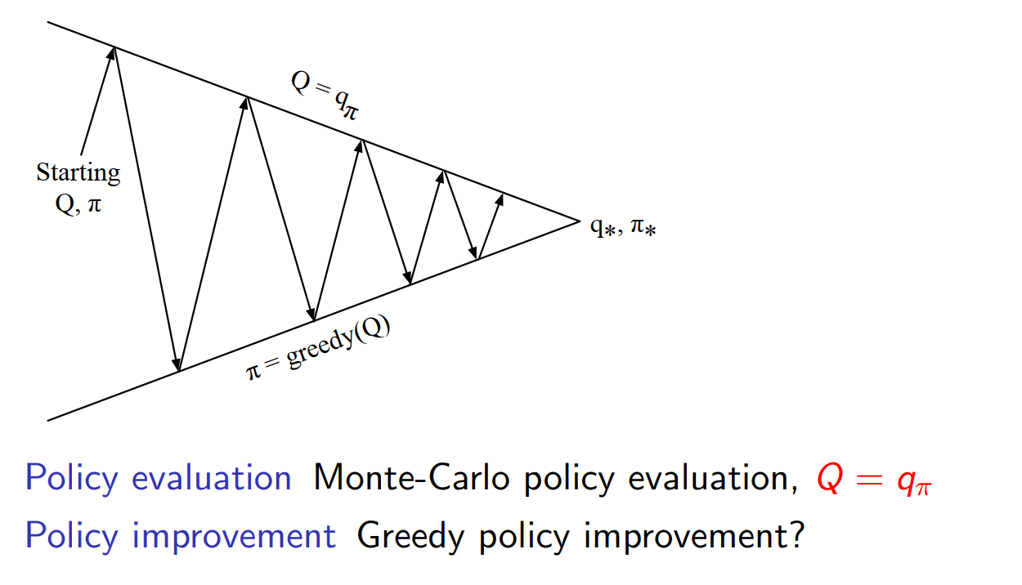
Policy Iteration using Action-Value Function
INTRODUCTION TO COMPUTING
Course Code: CCINCOM/L
Joseph Marvin R. Imperial
REINFORCEMENT LEARNING
NU College of Computing and Information Technologies
Course Code: CCRNFLRL

Slide 15
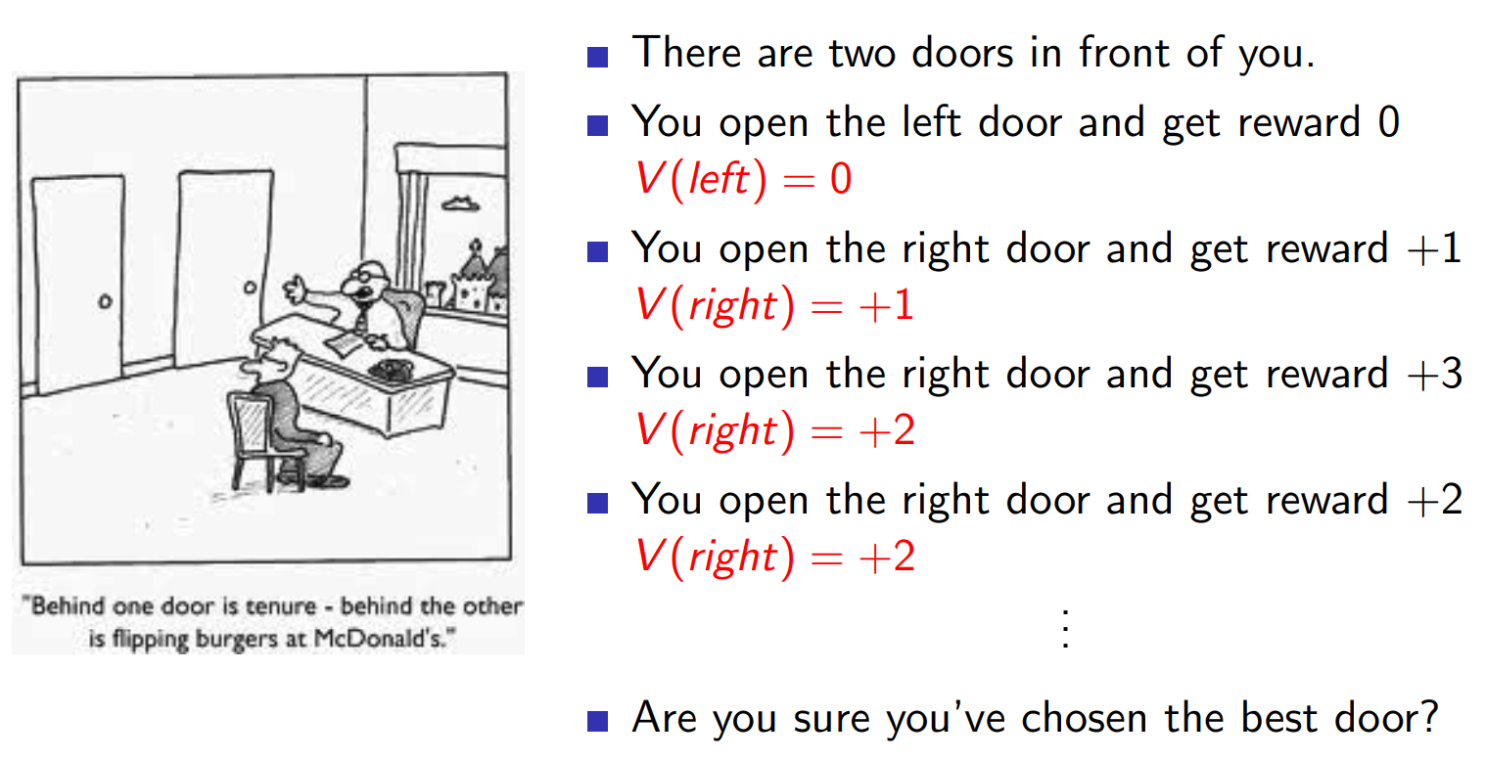
Greedy Action Selection
INTRODUCTION TO COMPUTING
Course Code: CCINCOM/L
Joseph Marvin R. Imperial
REINFORCEMENT LEARNING
NU College of Computing and Information Technologies
Course Code: CCRNFLRL

Slide 16
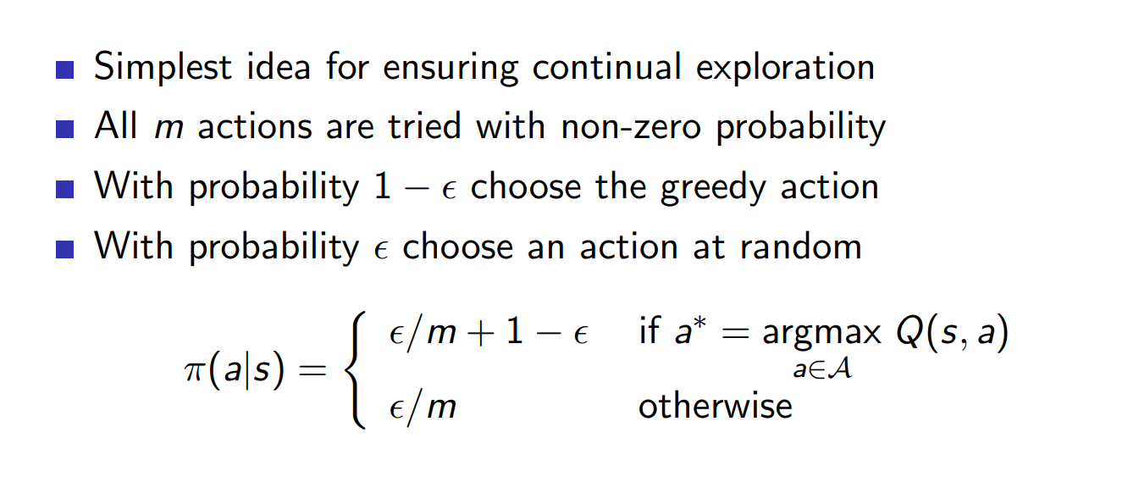
ε-Greedy Action Selection
INTRODUCTION TO COMPUTING
Course Code: CCINCOM/L
Joseph Marvin R. Imperial
REINFORCEMENT LEARNING
NU College of Computing and Information Technologies
Course Code: CCRNFLRL

Slide 17
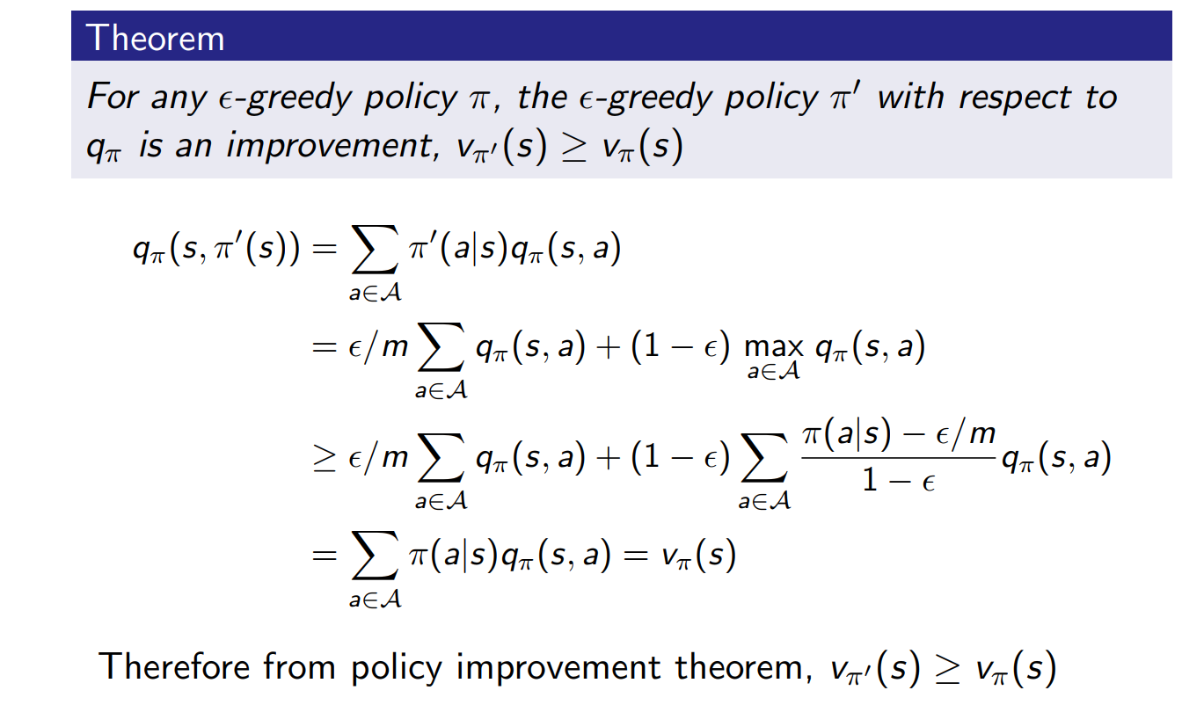
ε-Greedy Policy Improvement
INTRODUCTION TO COMPUTING
Course Code: CCINCOM/L
Joseph Marvin R. Imperial
REINFORCEMENT LEARNING
NU College of Computing and Information Technologies
Course Code: CCRNFLRL

Slide 18
Outline
INTRODUCTION TO COMPUTING
Course Code: CCINCOM/L
Introduction
On-Policy and Off-Policy
ε-Greedy Exploration
On-Policy
GLIE Monte-Carlo
SARSA
Off-Policy
Q-Learning
Joseph Marvin R. Imperial
REINFORCEMENT LEARNING
NU College of Computing and Information Technologies
Course Code: CCRNFLRL

Slide 19
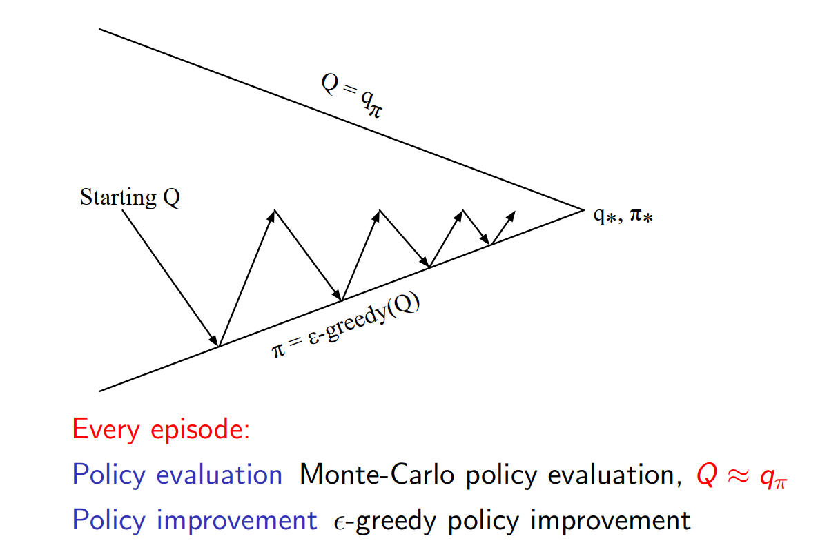
Monte-Carlo Control
INTRODUCTION TO COMPUTING
Course Code: CCINCOM/L
Joseph Marvin R. Imperial
REINFORCEMENT LEARNING
NU College of Computing and Information Technologies
Course Code: CCRNFLRL

Slide 20
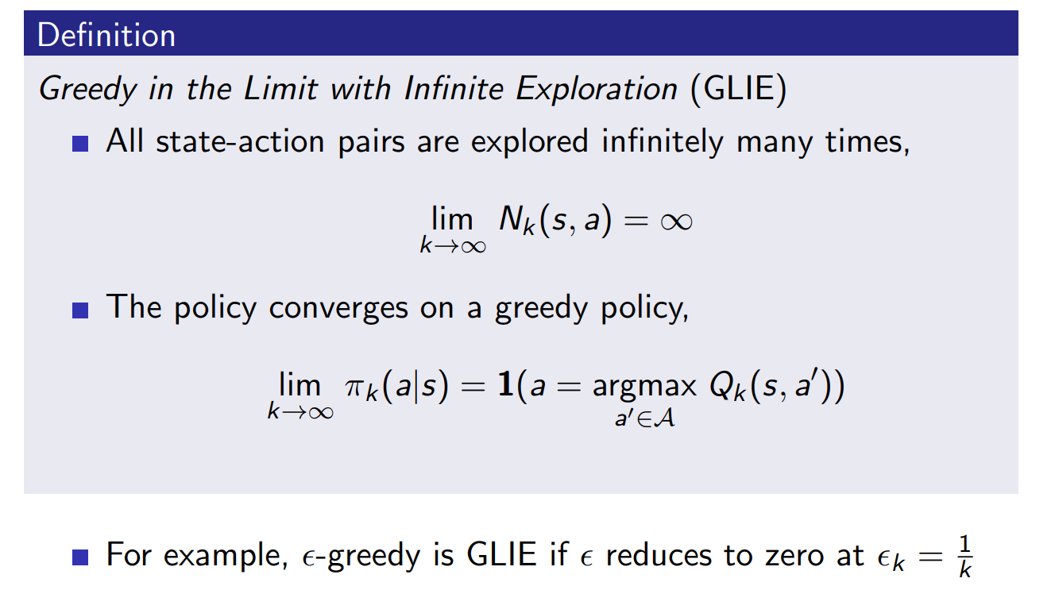
GLIE
INTRODUCTION TO COMPUTING
Course Code: CCINCOM/L
Joseph Marvin R. Imperial
REINFORCEMENT LEARNING
NU College of Computing and Information Technologies
Course Code: CCRNFLRL

Slide 21
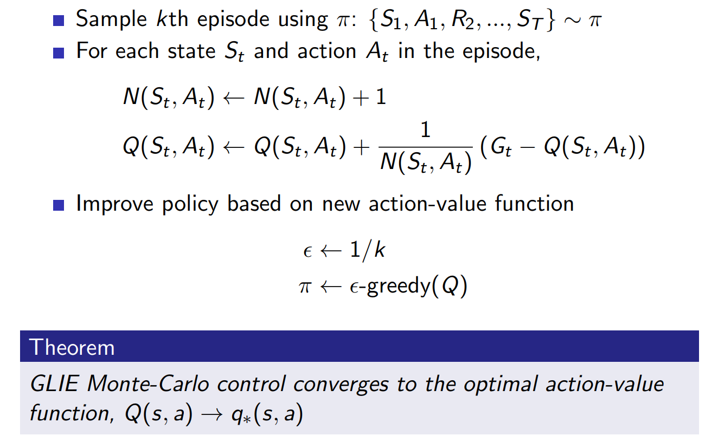
GLIE Monte Carlo Control
INTRODUCTION TO COMPUTING
Course Code: CCINCOM/L
Joseph Marvin R. Imperial
REINFORCEMENT LEARNING
NU College of Computing and Information Technologies
Course Code: CCRNFLRL

Slide 22
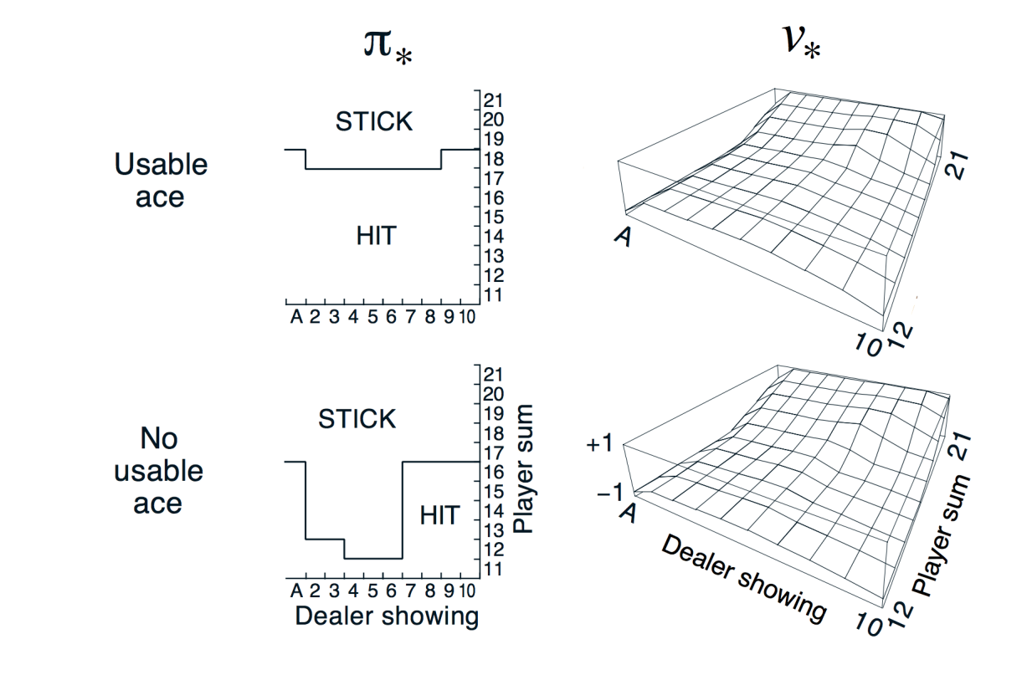
Monte Carlo Control in Blackjack
INTRODUCTION TO COMPUTING
Course Code: CCINCOM/L
Joseph Marvin R. Imperial
REINFORCEMENT LEARNING
NU College of Computing and Information Technologies
Course Code: CCRNFLRL

Slide 23
SARSA
INTRODUCTION TO COMPUTING
Course Code: CCINCOM/L
is an on-policy algorithm where in the current state S, an action A is taken and the agent gets a reward R and ends up in the next state S1 and take action A1 in S1, or in other words the tuple S, A, R, S1, A1.
New Q – Value Estimation
Current Q – Value Estimation
Learning Rate
Immediate Reward
Value of the next state-action pair
Current Q – Value Estimation
Joseph Marvin R. Imperial
REINFORCEMENT LEARNING
NU College of Computing and Information Technologies
Course Code: CCRNFLRL
Notes:
Start off with state S using action A
Sample from the environment to see what reward R we end up in and what state S we end up in.
We sample our own policy at that next state S1

Slide 24
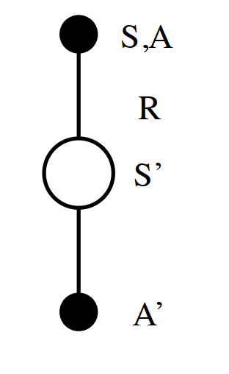
SARSA
INTRODUCTION TO COMPUTING
Course Code: CCINCOM/L
New Q – Value Estimation
Current Q – Value Estimation
Learning Rate
Immediate Reward
Value of the next state-action pair
Current Q – Value Estimation
Joseph Marvin R. Imperial
REINFORCEMENT LEARNING
NU College of Computing and Information Technologies
Course Code: CCRNFLRL
Notes:
Start off with state S using action A
Sample from the environment to see what reward R we end up in and what state S we end up in.
We sample our own policy at that next state S1

Slide 25
SARSA
INTRODUCTION TO COMPUTING
Course Code: CCINCOM/L
Initialize the action-value estimates Q(s, a) to some arbitrary values.
Set the initial state s.
Choose the initial action a using an epsilon-greedy policy based on the current Q values.
Take the action a and observe the reward r and the next state s’.
Choose the next action a’ using an epsilon-greedy policy based on the updated Q values.
Update the action-value estimate for the current state-action pair using the SARSA update rule:
Q(s, a) = Q(s, a) + alpha * (r + gamma * Q(s’, a’) – Q(s, a))
Joseph Marvin R. Imperial
REINFORCEMENT LEARNING
NU College of Computing and Information Technologies
Course Code: CCRNFLRL

Slide 26
Outline
INTRODUCTION TO COMPUTING
Course Code: CCINCOM/L
Introduction
On-Policy and Off-Policy
ε-Greedy Exploration
On-Policy
GLIE Monte-Carlo
SARSA
Off-Policy
Q-Learning
Joseph Marvin R. Imperial
REINFORCEMENT LEARNING
NU College of Computing and Information Technologies
Course Code: CCRNFLRL

Slide 27
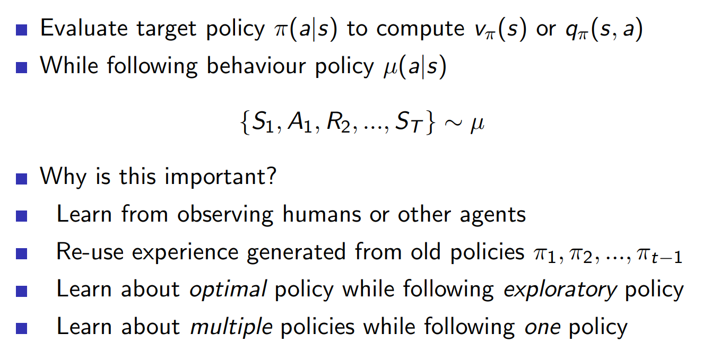
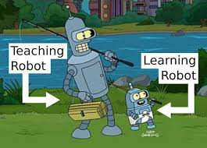
Off-Policy Learning
INTRODUCTION TO COMPUTING
Course Code: CCINCOM/L
Joseph Marvin R. Imperial
REINFORCEMENT LEARNING
NU College of Computing and Information Technologies
Course Code: CCRNFLRL

Slide 28
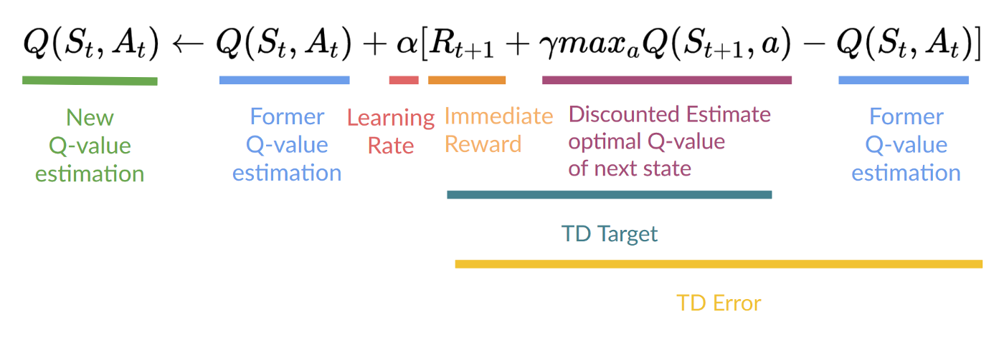
Q-Learning
INTRODUCTION TO COMPUTING
Course Code: CCINCOM/L
Is an off-policy value-based method that uses a TD approach to train its action-value function
Joseph Marvin R. Imperial
REINFORCEMENT LEARNING
NU College of Computing and Information Technologies
Course Code: CCRNFLRL

Slide 29
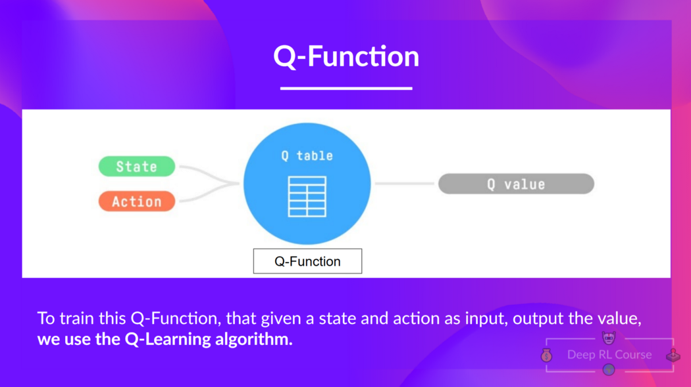
Q-Learning
INTRODUCTION TO COMPUTING
Course Code: CCINCOM/L
Joseph Marvin R. Imperial
REINFORCEMENT LEARNING
NU College of Computing and Information Technologies
Course Code: CCRNFLRL

Slide 30
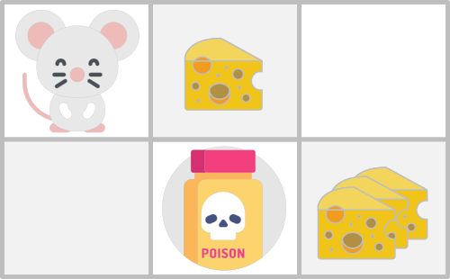
Q-Learning
INTRODUCTION TO COMPUTING
Course Code: CCINCOM/L
Joseph Marvin R. Imperial
REINFORCEMENT LEARNING
NU College of Computing and Information Technologies
Course Code: CCRNFLRL

Slide 31
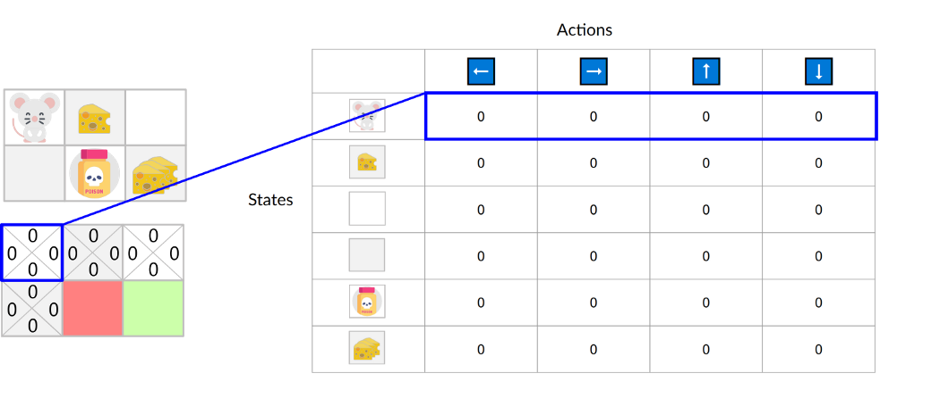
Q-Learning
INTRODUCTION TO COMPUTING
Course Code: CCINCOM/L
Q-Table is just a simple lookup table where we calculate the maximum expected future rewards for action at each state
This table will guide us to the best action at each state.
Joseph Marvin R. Imperial
REINFORCEMENT LEARNING
NU College of Computing and Information Technologies
Course Code: CCRNFLRL

Slide 32
Q-Learning
INTRODUCTION TO COMPUTING
Course Code: CCINCOM/L
The Q-table is initialized. That’s why all values are = 0. This table contains, for each state and action,
the corresponding state-action values.
Joseph Marvin R. Imperial
REINFORCEMENT LEARNING
NU College of Computing and Information Technologies
Course Code: CCRNFLRL

Slide 33
Q-Learning
INTRODUCTION TO COMPUTING
Course Code: CCINCOM/L
For this simple example, the state is only defined by the position of the mouse.
Joseph Marvin R. Imperial
REINFORCEMENT LEARNING
NU College of Computing and Information Technologies
Course Code: CCRNFLRL

Slide 34
Q-Learning
INTRODUCTION TO COMPUTING
Course Code: CCINCOM/L
Therefore, we have 2 x 3 rows in our Q-table, one row for each possible position of the mouse
Joseph Marvin R. Imperial
REINFORCEMENT LEARNING
NU College of Computing and Information Technologies
Course Code: CCRNFLRL

Slide 35
Q-Learning
INTRODUCTION TO COMPUTING
Course Code: CCINCOM/L
Here we see that the state-action value of the initial state and going up is 0:
Joseph Marvin R. Imperial
REINFORCEMENT LEARNING
NU College of Computing and Information Technologies
Course Code: CCRNFLRL

Slide 36
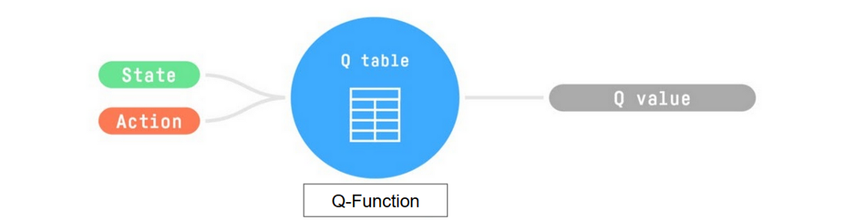
Q-Learning
INTRODUCTION TO COMPUTING
Course Code: CCINCOM/L
So, the Q-function uses a Q-table that has the value of each state-action pair.
Joseph Marvin R. Imperial
REINFORCEMENT LEARNING
NU College of Computing and Information Technologies
Course Code: CCRNFLRL

Slide 37
Q-Learning
INTRODUCTION TO COMPUTING
Course Code: CCINCOM/L
Given a state and action, our Q-function will search inside its Q-table to output the value.
Joseph Marvin R. Imperial
REINFORCEMENT LEARNING
NU College of Computing and Information Technologies
Course Code: CCRNFLRL

Slide 38
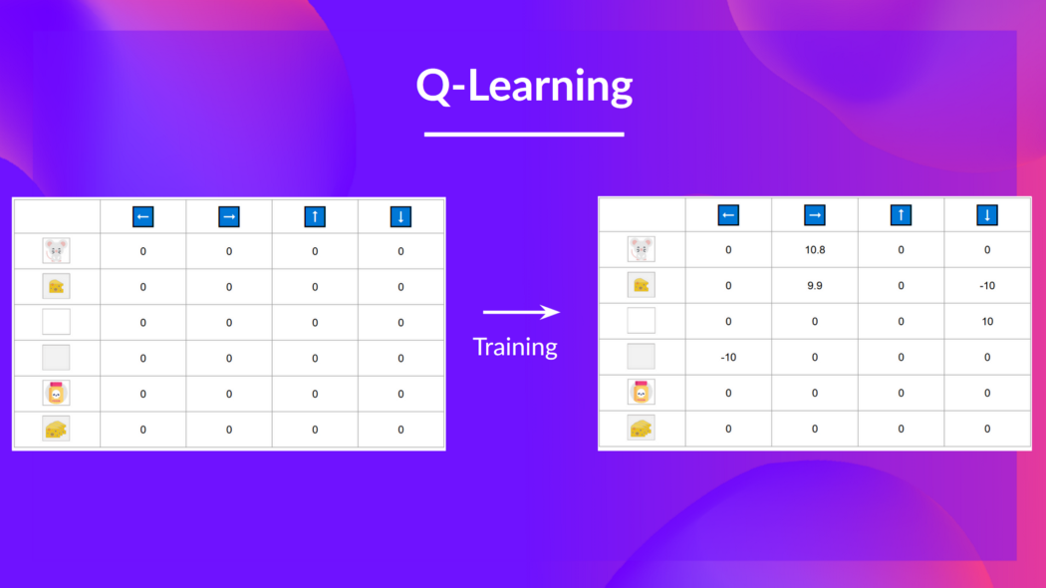
Q-Learning
INTRODUCTION TO COMPUTING
Course Code: CCINCOM/L
In the beginning, our Q-table is useless since it gives arbitrary values for each state-action pair (most of the time, we initialize the Q-table to 0).
Joseph Marvin R. Imperial
REINFORCEMENT LEARNING
NU College of Computing and Information Technologies
Course Code: CCRNFLRL

Slide 39
Q-Learning
INTRODUCTION TO COMPUTING
Course Code: CCINCOM/L
As the agent explores the environment and we update the Q-table, it will give us a better and better approximation to the optimal policy.
Joseph Marvin R. Imperial
REINFORCEMENT LEARNING
NU College of Computing and Information Technologies
Course Code: CCRNFLRL

Slide 40
Q-Learning
INTRODUCTION TO COMPUTING
Course Code: CCINCOM/L
We see here that with the training, our Q-table is better since, thanks to it, we can know the value of each state-action pair.
Joseph Marvin R. Imperial
REINFORCEMENT LEARNING
NU College of Computing and Information Technologies
Course Code: CCRNFLRL

Slide 41
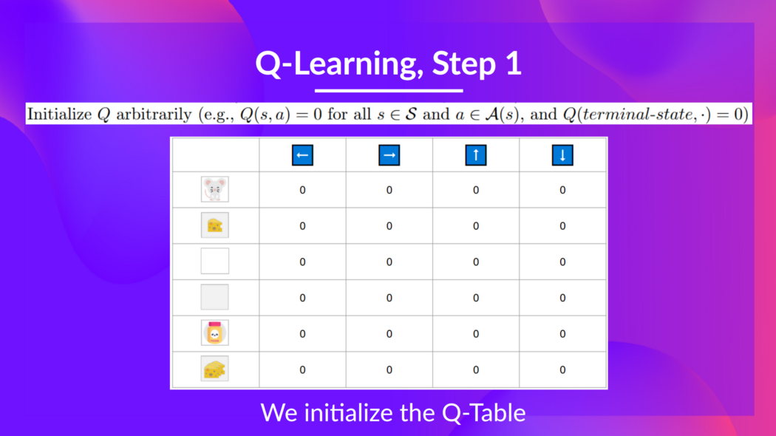
Q-Learning
INTRODUCTION TO COMPUTING
Course Code: CCINCOM/L
Joseph Marvin R. Imperial
REINFORCEMENT LEARNING
NU College of Computing and Information Technologies
Course Code: CCRNFLRL

Slide 42
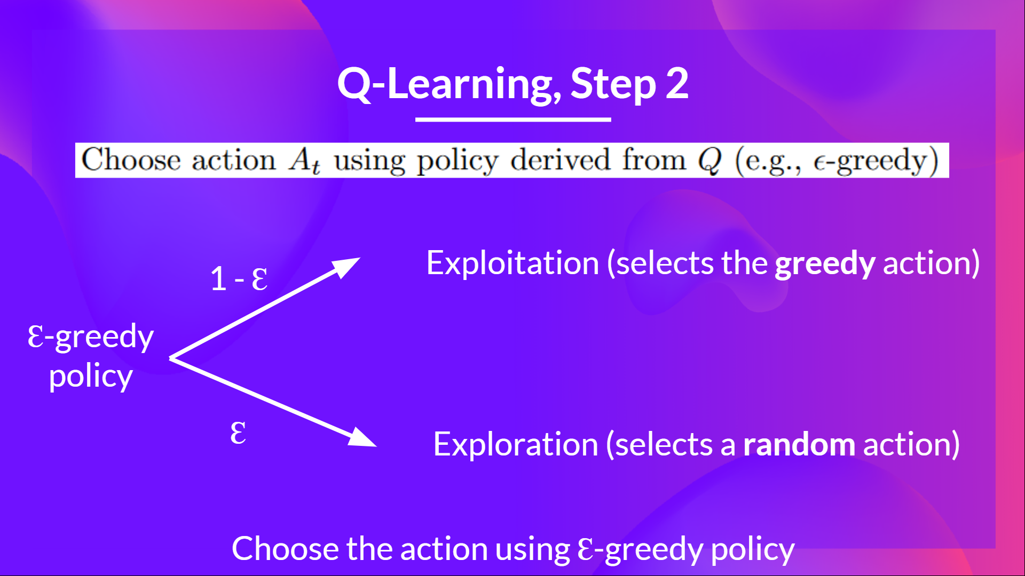
Q-Learning
INTRODUCTION TO COMPUTING
Course Code: CCINCOM/L
Joseph Marvin R. Imperial
REINFORCEMENT LEARNING
NU College of Computing and Information Technologies
Course Code: CCRNFLRL

Slide 43
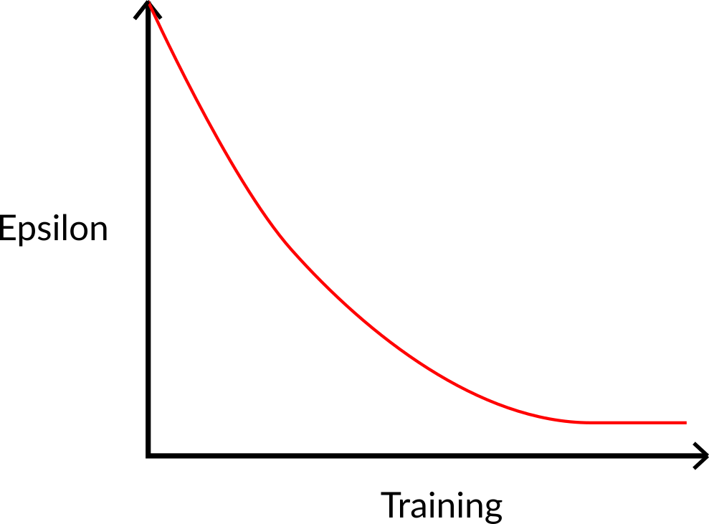
Step 2: Choose an Action using the epsilon-greedy strategy
INTRODUCTION TO COMPUTING
Course Code: CCINCOM/L
Joseph Marvin R. Imperial
REINFORCEMENT LEARNING
NU College of Computing and Information Technologies
Course Code: CCRNFLRL

Slide 44
Step 2: Choose an Action using the epsilon-greedy strategy
INTRODUCTION TO COMPUTING
Course Code: CCINCOM/L
The idea is that, with an initial value of ɛ = 1.0:
With probability 1 — ɛ : we do exploitation (aka our agent selects the action with the highest state-action pair value).
With probability ɛ: we do exploration (trying random action).
Joseph Marvin R. Imperial
REINFORCEMENT LEARNING
NU College of Computing and Information Technologies
Course Code: CCRNFLRL

Slide 45
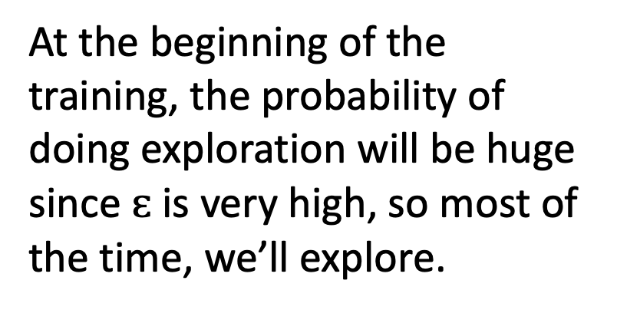
Step 2: Choose an Action using the epsilon-greedy strategy
INTRODUCTION TO COMPUTING
Course Code: CCINCOM/L
At the beginning of the training, the probability of doing exploration will be huge since $ɛ$ is very high, so most of the time, we’ll explore.
Joseph Marvin R. Imperial
REINFORCEMENT LEARNING
NU College of Computing and Information Technologies
Course Code: CCRNFLRL

Slide 46
Step 2: Choose an Action using the epsilon-greedy strategy
INTRODUCTION TO COMPUTING
Course Code: CCINCOM/L
But as the training goes on, and consequently our Q-table gets better and better in its estimations.
Joseph Marvin R. Imperial
REINFORCEMENT LEARNING
NU College of Computing and Information Technologies
Course Code: CCRNFLRL

Slide 47
Step 2: Choose an Action using the epsilon-greedy strategy
INTRODUCTION TO COMPUTING
Course Code: CCINCOM/L
We progressively reduce the epsilon value since we will need less and less exploration and more exploitation.
Joseph Marvin R. Imperial
REINFORCEMENT LEARNING
NU College of Computing and Information Technologies
Course Code: CCRNFLRL

Slide 48

Step 3: Perform Action, Get Reward and Next State
INTRODUCTION TO COMPUTING
Course Code: CCINCOM/L
Joseph Marvin R. Imperial
REINFORCEMENT LEARNING
NU College of Computing and Information Technologies
Course Code: CCRNFLRL

Slide 49
Step 4: Update Q-value
INTRODUCTION TO COMPUTING
Course Code: CCINCOM/L
Joseph Marvin R. Imperial
REINFORCEMENT LEARNING
NU College of Computing and Information Technologies
Course Code: CCRNFLRL

Slide 50
Q-Learning
INTRODUCTION TO COMPUTING
Course Code: CCINCOM/L
Trains a Q-function (an action-value function), which internally is a Q-table that contains all the state-action pair values.
Given a state and action, our Q-function will search its Q-table for the corresponding value.
When the training is done, we have an optimal Q-function, which means we have optimal Q-table.
And if we have an optimal Q-function, we have an optimal policy since we know the best action to take at each state.
Joseph Marvin R. Imperial
REINFORCEMENT LEARNING
NU College of Computing and Information Technologies
Course Code: CCRNFLRL

Slide 51
References
INTRODUCTION TO COMPUTING
Course Code: CCINCOM/L
Images are licensed with Creative Commons. Can use without citing.
Prof. Emma Brunskill’s slides (CS234RL). https://web.stanford.edu/class/cs234/slides/lecture1.pdf
David Silver’s slides. https://www.davidsilver.uk/wp-content/uploads/2020/03/intro_RL.pdf
Review in Probability, Intro to RL Concepts
Joseph Marvin R. Imperial
REINFORCEMENT LEARNING
NU College of Computing and Information Technologies
Course Code: CCRNFLRL

